Slide 1
Product Info Microservice

Slide 2
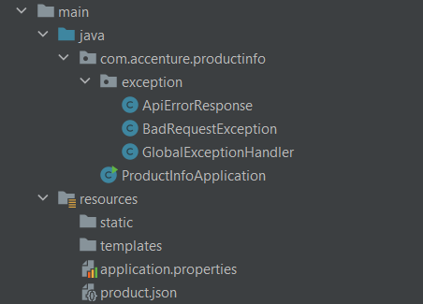
Starter Application
What are the objectives?
A starter application will be provided to kick off your assessment. It includes the following:
Exception handlers
The product.json file
Run the application to confirm it is operational and check the console for the following message:
Tomcat has started on port 8082 (http) with the context path '/’.
If the port number differs, please update it accordingly.

Slide 3
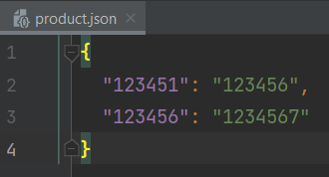
What are the objectives?
What are the objectives?
Develop an application that:
Retrieves product ID from product code found in the product.json file.
Handles missing product codes by throwing a BadRequestException with a relevant error message.
Ensures proper exception handling when the JSON file cannot be read, returning a server error response
Product Code
Product Id

Slide 4
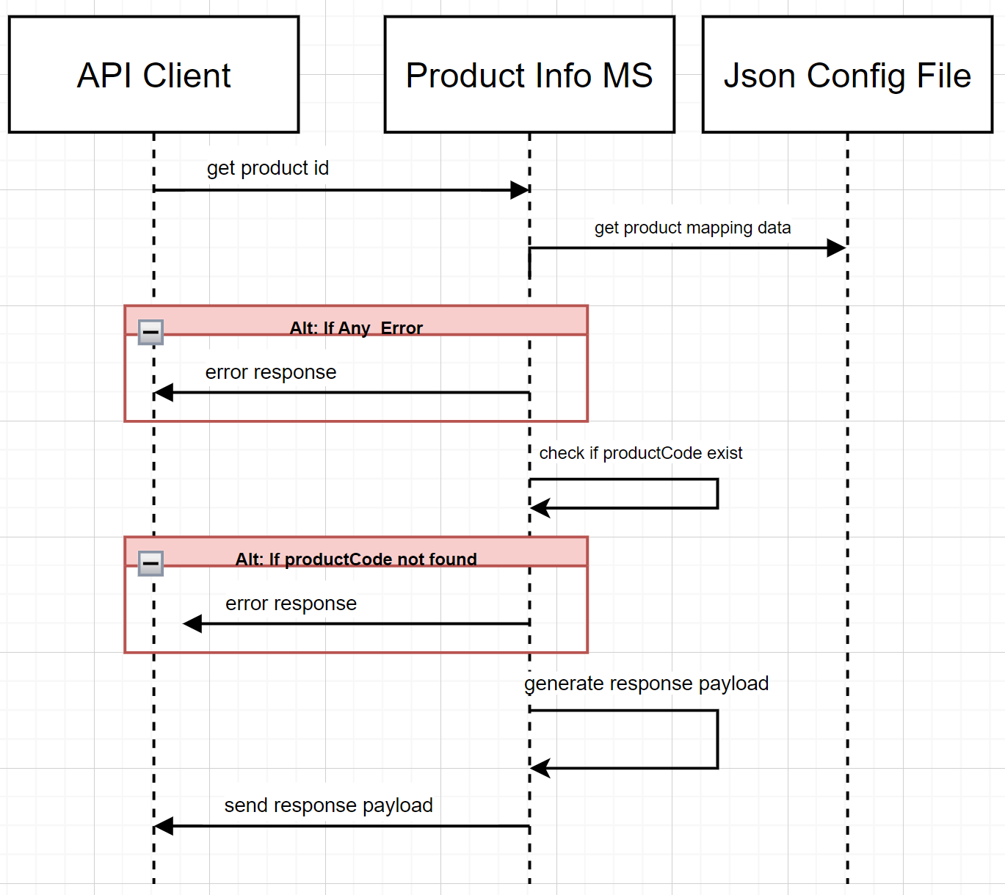
Sequence Diagram
What are the objectives?
A sequence diagram in UML (Unified Modeling Language) is a type of interaction diagram that shows how objects interact in a particular scenario of a use case.
It emphasizes the sequence of messages exchanged between objects over time.
The API client (Postman) requests a product ID from the Product Info Microservice using a product code.
The service checks a JSON config file to find the product ID.
If the JSON file can't be read or if the product code doesn't exist in the file, an error is returned.
If the product code is valid, the service responds with the product ID in JSON format.

Slide 5
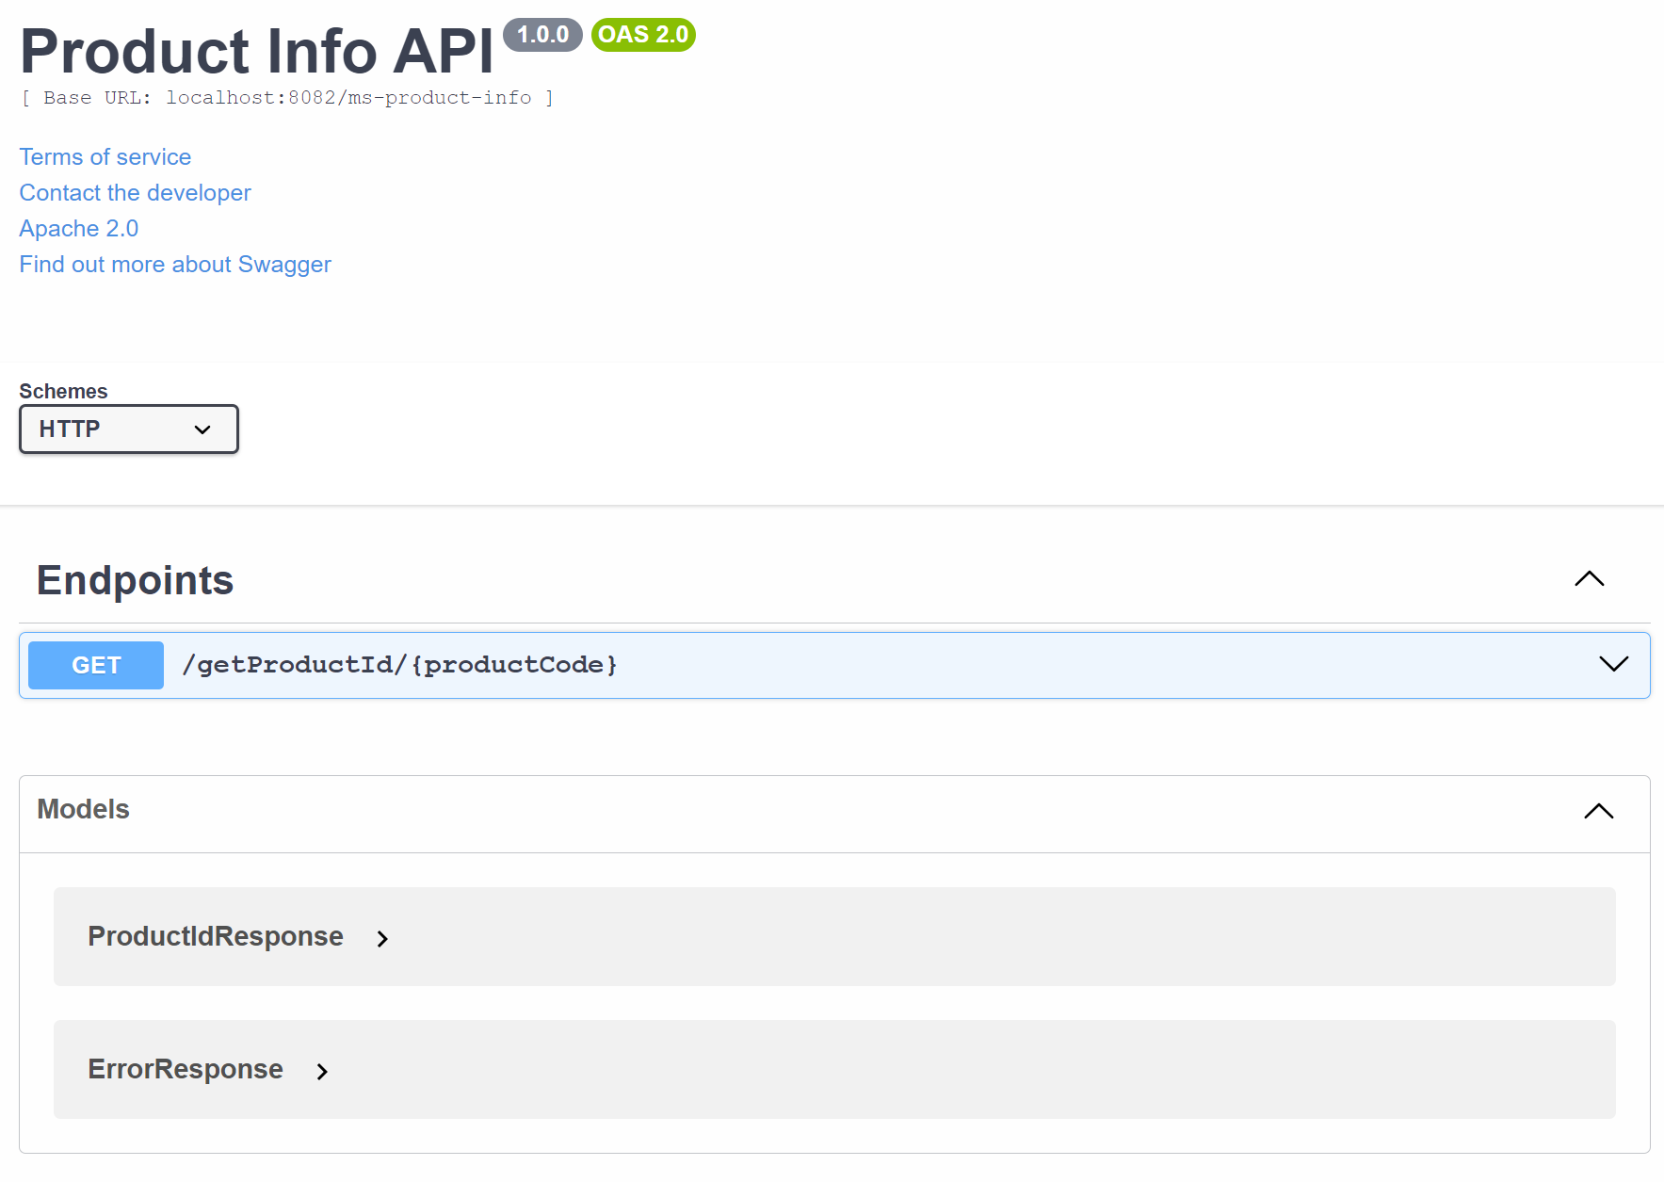
Swagger
What are the objectives?
Swagger is a framework used for designing, building, and documenting RESTful APIs.
It provides a standardized way to describe the structure and behavior of APIs through a clear and interactive interface.

Slide 6
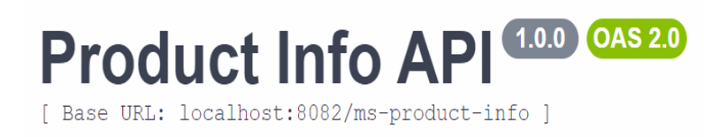
Base URL
What are the objectives?
in a Spring Boot application, the base URL is typically specified using the @RequestMapping annotation at the class level.
This sets a common prefix for all the endpoint mappings within that controller class making it easier to manage and organize your API routes.
Base URL Declaration:
The @RequestMapping("/ms-product-info") at the class level sets the base URL for all endpoints within the ProductController.
This means that all endpoints in this controller will start with /ms-product-info, resulting in the full base URL localhost:8082/ms-product-info.

Slide 7
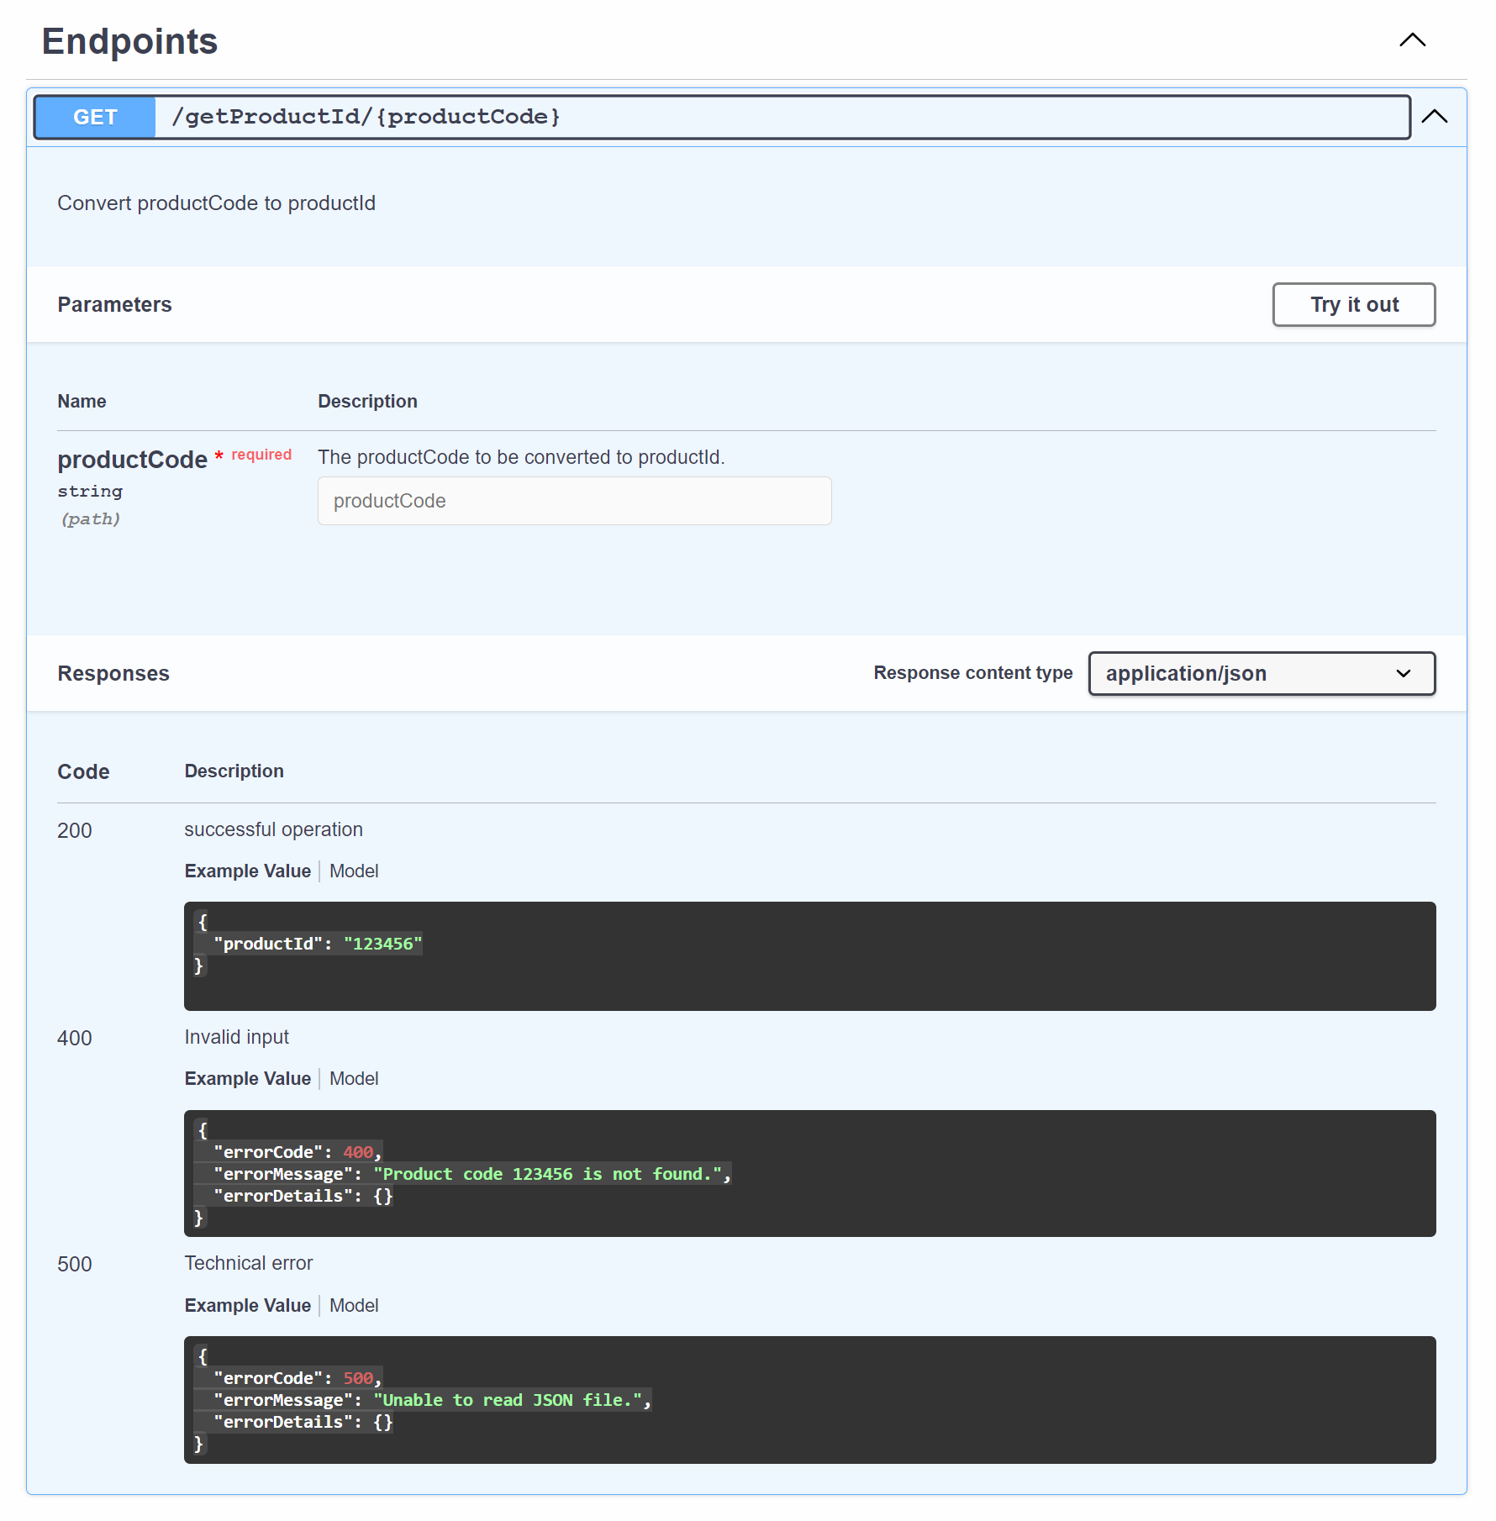
Endpoints
What are the objectives?
In the context of Spring Boot or RESTful web services, an endpoint is a specific URL that a client can use to interact with the server. Each endpoint in a RESTful service corresponds to a particular resource or action that the service provides.
An endpoint in Spring Boot is a URL that maps to a method in a controller class. This URL is used to perform operations such as retrieving, creating, updating, or deleting resources.
Base URL: /ms-product-info (defined at the class level).
Endpoint URL: /getProductId/{productCode} (defined at the method level).
Function: Retrieves a product ID based on the productCode provided in the URL path.

Slide 8
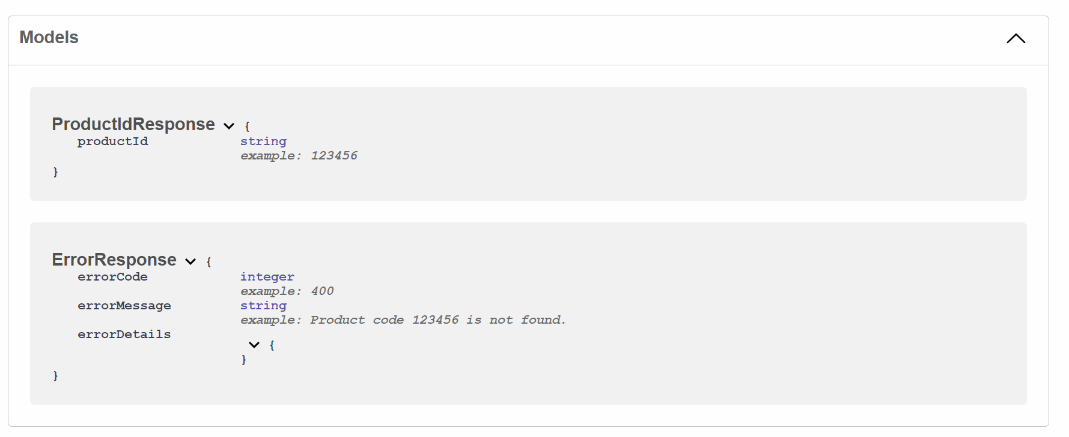
Models
What are the objectives?
Models refer to the data structures that represent the format of the data exchanged between the client and the server. They define how data is structured and validated within your application.
Explanation of the ProductIdResponse Model
ProductIdResponse is a model used to define the structure of the response that the server sends back to the client when a request is made.

Slide 9
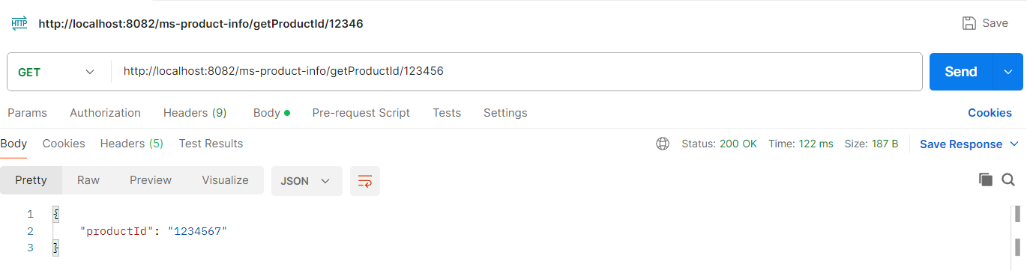

How to test?
What are the objectives?
To test the endpoints using Postman, open the Postman application and create a new request.
Set the appropriate request method (such as GET, POST, PUT, or DELETE) and enter the correct URL for the endpoint you want to test.
Click "Send" to make the request, and then review the response in Postman to check if it matches your expectations. This allows you to verify that your API endpoints are functioning correctly.
Valid scenario: GET http://localhost:8082/ms-product-info/getProductId/123456
Product Code
Product Id

Slide 10
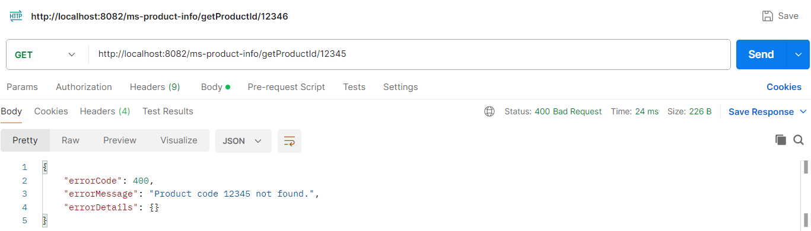
How to test?
What are the objectives?
Invalid input: GET http://localhost:8082/ms-product-info/getProductId/12345
Ensure that the status code returned in Postman matches the expected status code for your request.
This confirms that the response from the server aligns with the expected outcome for the scenario being tested."

Slide 11
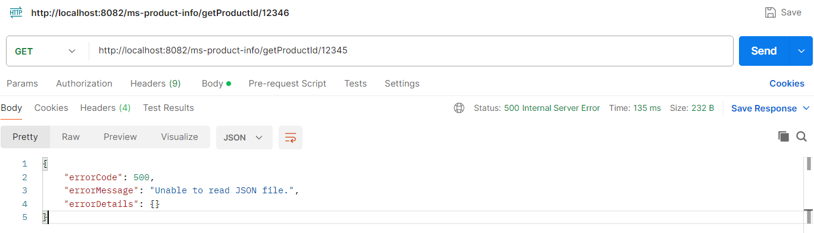
How to test?
What are the objectives?
Technical Error: GET http://localhost:8082/ms-product-info/getProductId/12345

Slide 12
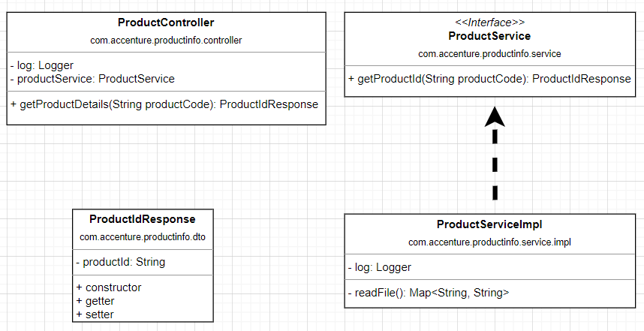
Class Diagram
What are the objectives?
A class diagram is a type of static structure diagram in the Unified Modeling Language (UML) that describes the structure of a system by showing its classes, attributes, operations (or methods), and the relationships among objects. It is a blueprint of the system's design and is used to visualize, specify, construct, and document the artifacts of a software system.
readFile() method should be called within the getProductId() method

Slide 13
Unit Test
What are the objectives?
Location: Create the unit test class under the test folder in your project directory.
Package Name: The package name of the test class should match the package name of the class you are testing. For example, if the ProductServiceImpl class is located in the package com.accenture.productinfo.service.impl, then the test class should also be in com.accenture.productinfo.service.impl.
Class Name: Name the test class ProductServiceImplemTest to clearly indicate that it tests the ProductServiceImpl class.
Test Method Name | Method to Test | Description | Test Condition | Expected Result
testGetProductId_ValidProductCode | ProductServiceImpl.getProductId | Get the product id of a valid product code. | Call ProductServiceImpl.getProductId .getProductId("123456") | Verify that the returned data includes the following productId: "1234567"
testGetProductId_InvalidProductCode | ProductServiceImpl.getProductId | Test that an invalid product code throws a BadRequestException with the expected error message and status code. | Call ProductServiceImpl.getProductId .getProductId("12345") | Verify that the returned data includes the following: errorId: 400 errorMessage: "Product code 123452 not found." errorDetails of an empty map.

Slide 14
FAQ – Frequently Asked Questions
An error was encountered : org/springframework/boot/SpringApplication has been compiled by a more recent version of the Java Runtime (class file version 61.0), this version of the Java Runtime only recognizes class file versions up to 55.0
About the error: The error indicates that your project is using a version of Spring Boot compiled with a newer version of Java than the one you are currently using. To resolve this, you need to update your Java version to match the version used by Spring Boot.
Solution:
Check the required Java version for your Spring Boot version: Spring Boot 2.5.x requires Java 11, while Spring Boot 3.x requires Java 17.
Update your Java Development Kit (JDK): Ensure you have the correct JDK installed. You can download the latest JDK from Downloads for Amazon Corretto 17 - Amazon Corretto 17
Update your IDE settings: Ensure IntelliJ IDEA is configured to use the correct JDK.
Step 1:
Go to File > Project Structure.
Under Project Settings, select Project.
Set the Project SDK to the correct JDK version.
Set the Project language level to the corresponding Java version.
After making these changes, rebuild your project to ensure it uses the correct Java version.
Step 2:
Verify if the Run Configuration uses the correct JDK:
Click on Run > Edit Configurations. Under Build and Run, select the appropriate JDK.
Update your pom.xml: Ensure your Maven project is configured to use the correct Java version.
Can I use Github Copilot? Yes, you can use GitHub Copilot. It will help you accelerate your development process during the bootcamp.

Slide 15
Guidance for your Demo
A proper demo goes beyond just executing requests in Postman.
Clear Explanation: Start by clearly explaining the purpose of the demo. Describe the endpoint you're testing, the scenario, and what you expect to show. Scenario: For this demonstration, I will use a product code 12345 that does not exist in our JSON file. This will help us see how the API handles requests for non-existent products.
Expectation: We expect the API to return a 400 Bad Request status code with a detailed error message indicating that the product code was not found. This will show us how the system handles errors and provides feedback when the requested product is not available."
You can demonstrate the endpoints as soon as you have created them. JUnit tests can be demonstrated afterwards.

